Slide 1

Ethics Without Easy Answers

Slide 2

THE CORE PROBLEM
Contradictions Dumped at Your Feet (O'Mahoney)
"Contradictions and conflicts" in consulting practice are ultimately "dumped at the feet of the individual."
Consultants face ethical dilemmas without professional backstops.
No qualification requirements. No licensing body. No disciplinary tribunal. No mechanism to strike off practitioners who cross lines.
Market reputation (and general legal standards) as the only enforcement.
Freedom comes with ethical weight — you need to develop your own compass

Slide 3

WHO TO WORK FOR?
McKinsey and the Opioid Crisis
1
2004–2019
McKinsey advises Purdue Pharma on OxyContin sales strategy, earning $93 million
2
Commercial Success
Helped identify "high value prescribers"—
including doctors writing unsafe prescriptions
3
Document Destruction
Senior partner deletes documents during investigation
4
December 2024
$650 million criminal settlement—
first consulting firm held criminally responsible
McKinsey's statement: "We should not have undertaken sales and marketing work for Purdue Pharma. This terrible public health crisis and our past work for opioid manufacturers will always be a source of profound regret."
Combination of individual and organisational failures of judgement — likely followed by escalation of commitment. How to keep morally aware?

Slide 4
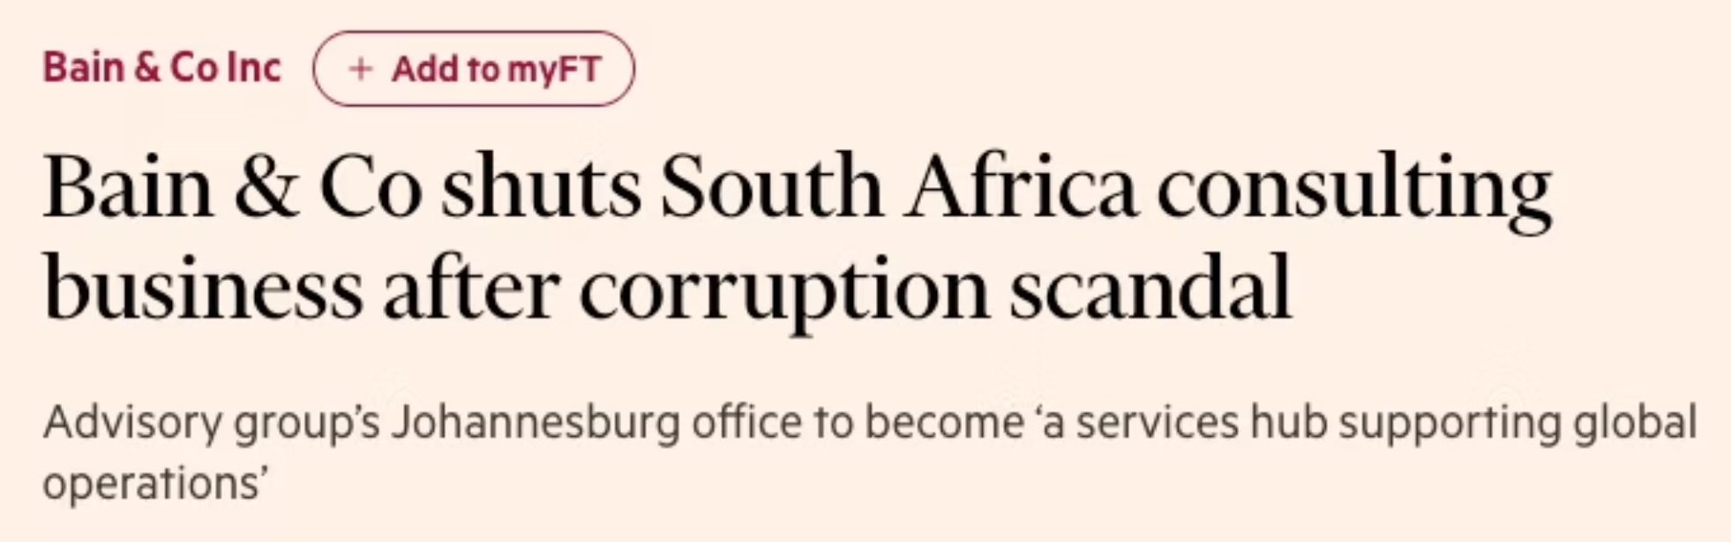

WHO IS YOUR CLIENT?
The Presidents Vs the People
Restructured South African Revenue Service, deliberately weakening the state's capacity to collect taxes to benefit Jacob Zuma and allies.
Consequences:
South Africa banned Bain for 10 years from government contracts
UK Cabinet Office banned Bain from government contracts for three years, citing "grave professional misconduct” (lifted by court)
In the public sector, it appears fairly clear whose interests should have won out here. When do these lines become blurry?

Slide 5

CONFLICTS OF INTEREST?
Arthur Andersen's Collapse
$52M
28,000
Total Fees from Enron
Jobs Lost
$25M audit + $27M consulting in 2000 alone
The end of Arthur Andersen
When Enron's fraud began unravelling, Andersen's response was to accelerate document destruction.
Partner David Duncan ordered deleting emails and shredding documents when the SEC investigated.
Firm convicted for obstruction of justice (and other poor auditing practices were revealed).
Collapsed before Supreme Court overturned conviction.
Consultancies can face conflicts of interest - here audit vs. consulting. Some can be outlawed (e.g. Sarbanes-Oxley regulation in US), but at other times, this needs to be managed deliberately.

Slide 6

Ethical Individualisation (O'Mahoney)
01
02
Low-level ethics training
Structural problems downplayed
Firms focus on basic issues: don't accept expensive gifts, protect confidential information. Issues no reasonable person would dispute (though mistakes do happen).
Organisation-level challenges remain untouched: conflicts of interest, pressure to sell follow-on work, taking credit for client achievements, promising more than can be delivered.
03
04
Feel-good initiatives
Individual burden
Corporate volunteering creates positive PR whilst structural incentives creating ethical problems stay intact.
Individual consultants bear the weight of ethical choices whilst institutional structures make those choices difficult.
"Be ethical" isn't enough when the system you work in creates ethical traps.
Individual virtue can't compensate for institutional design.

Slide 7

Where Are Your Lines?
Which industries?
Which clients?
Which project aims?
Would you refuse to work with arms manufacturers? Fossil fuel companies? Gambling? Tobacco? Surveillance technology?
Would you decline governments with poor human rights records? Companies with exploitative labour practices? Organisations facing credible allegations of harm?
Would you reject helping a client avoid legitimate taxation? Optimising redundancy processes? Greenwashing? Rubber-stamp decisions you cannot fully assess?
If you haven't decided where your lines are before you face them, you're more likely to cross them.
Notes:
While institutional level governance matters

Slide 8




When to Walk Away
Sometimes the ethical choice is to decline or exit an engagement — e.g., when
You cannot deliver what the client needs
Project aims conflict with your values
You're legitimising a troubling conclusion
Continuing would cause harm
Continuing would mean taking money for value you can't provide
Success as defined would mean something you can't endorse
Your role is to provide cover for a solution you cannot stand behind
To employees, to communities, to the broader system
This is hard. There are financial pressures, relationship pressures, career pressures.
Walking away is sometimes the highest form of professional service—refusing to be complicit in harm. It is also the only way to prove—to yourself and others—that you are an independent advisor.

Slide 9
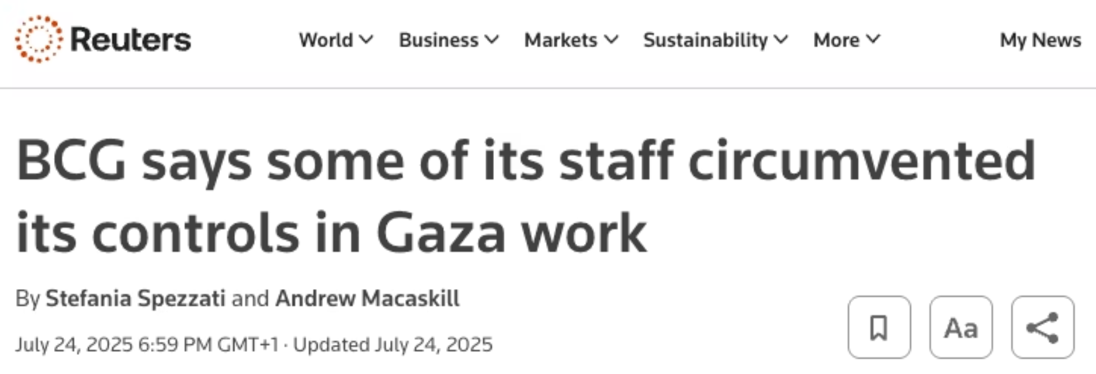

ORGANIZATIONAL CITIZENSHIP BEHAVIOURS
BCG and the Gaza Humanitarian Foundation
Work from late 2023 on what would become the Gaza Humanitarian Foundation—an aid distribution organisation backed by Israeli and US governments.
On launch in 2025, reports emerged that BCG consultants had modelled "redevelopment and resettlement scenarios"—scenarios that UN officials likened to ethnic cleansing.
After internal employee backlash (and public criticism), BCG withdrew in June 2025. Two partners were fired for what BCG called "unauthorised" work that didn't meet firm standards. The CEO issued a public apology, admitting "process failures."
Employee conscience isn't powerless. But it requires willingness to speak up—and to risk consequences.

Slide 10

SO WHAT?
Final Thoughts
Co-production Works
Beliefs Are Key
Recommendations work best when they emerge from genuine collaboration—when clients see them as arising from their own situation, not imposed from outside.
Getting buy-in requires understanding what people believe, not just presenting data. Success is about seeing a change for the client.
Evidence Matters, But...
Ethics Can't Be Delegated
The real skill is knowing what evidence helps and when you need to avoid blind-spots and focus on the context.
Without external regulation, you must develop your own framework—and be prepared to walk away.
None of this is easy. But it's what makes consulting something more than just exchanging time for money.
Think about an ethical line you would not cross.
How would you know if you were approaching it? What would it take for you to walk away?
Notes:
Armenakis

